Slide 1
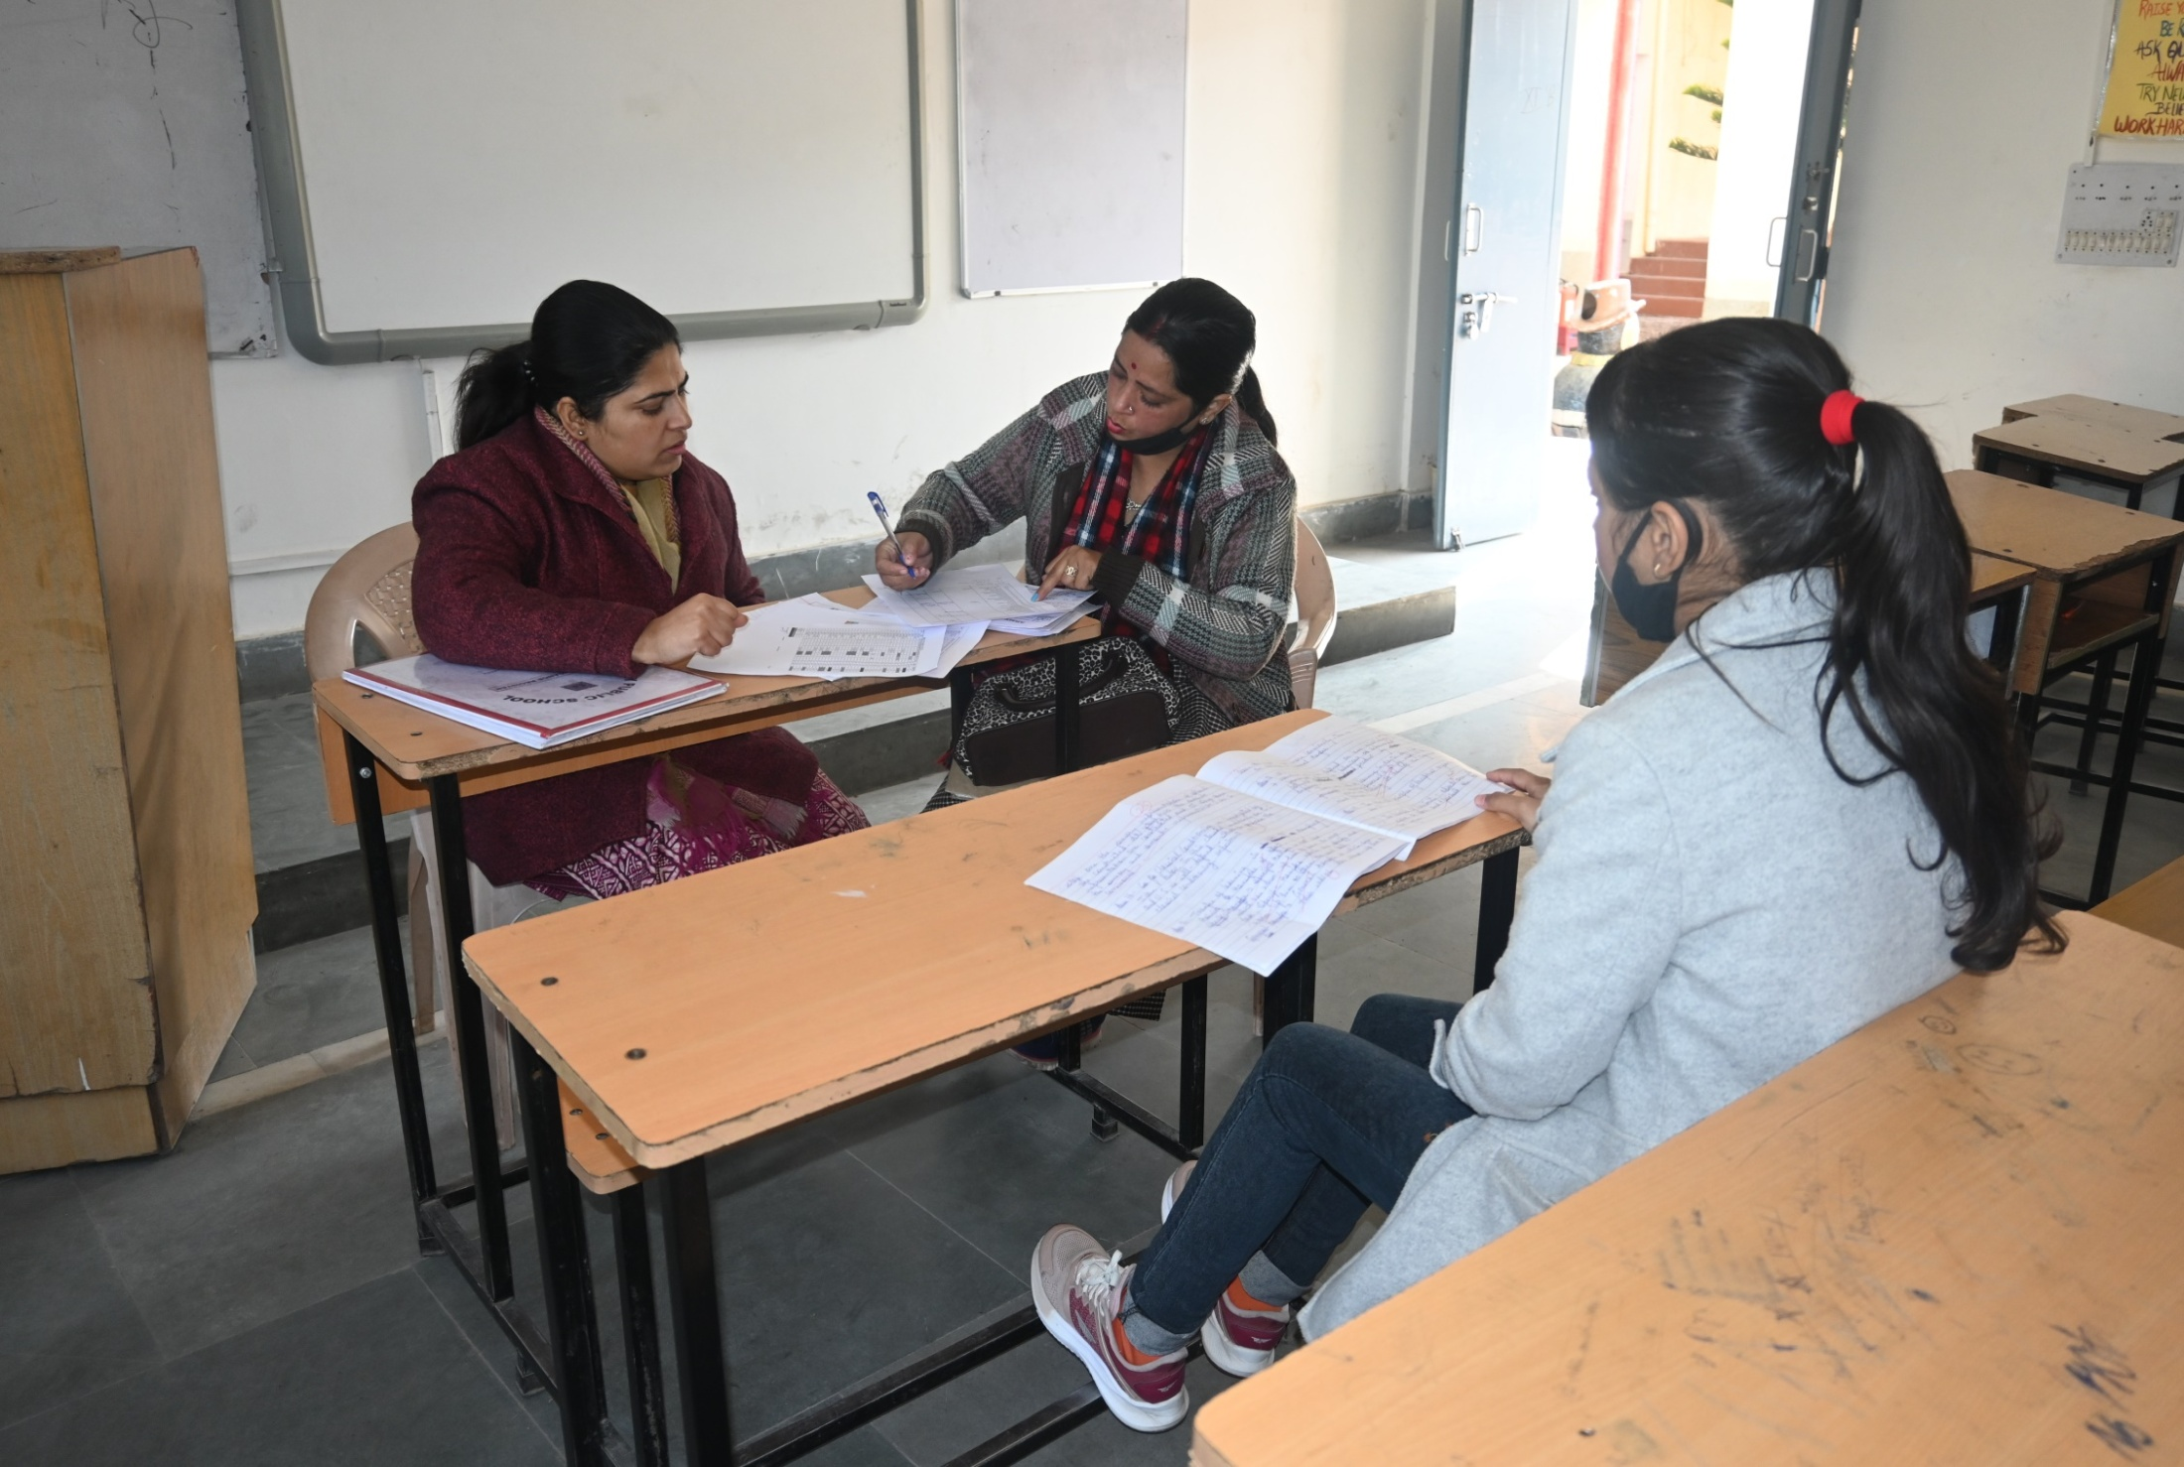
PARENTS COUNSELING SESSION

Slide 2
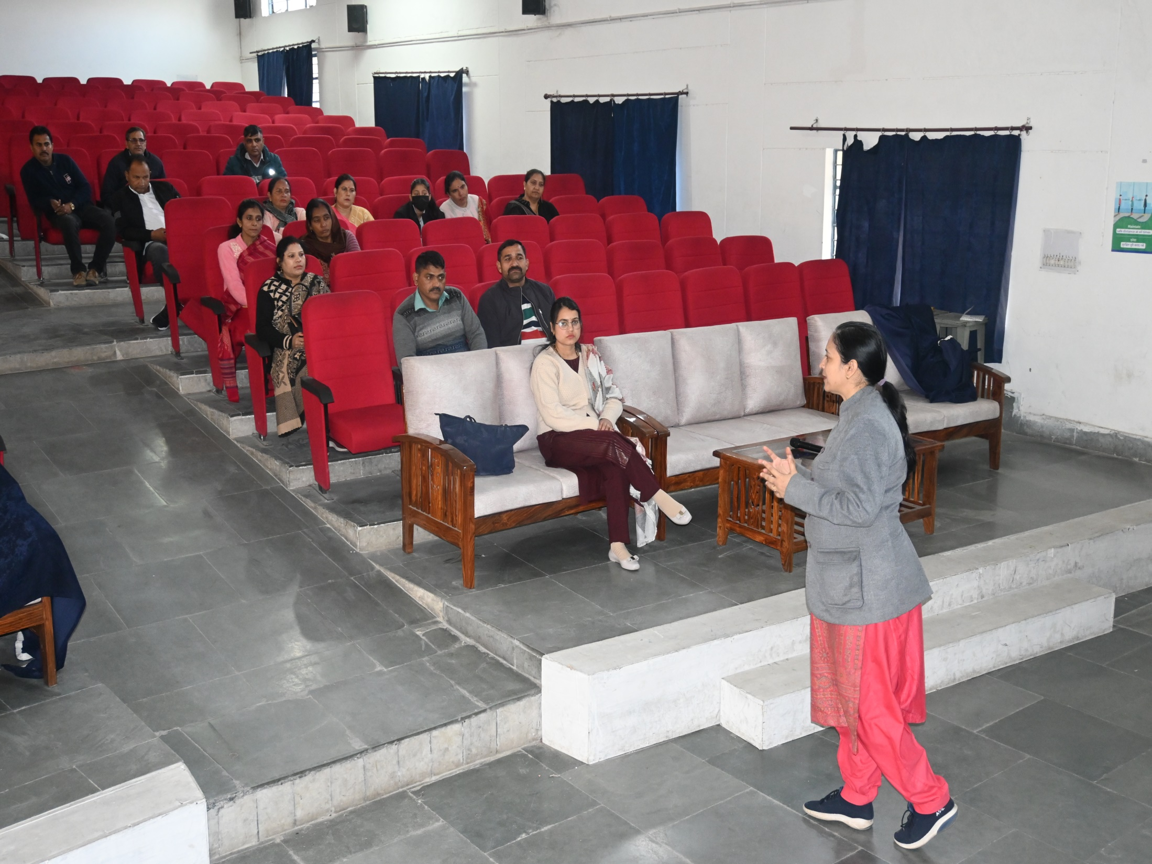
PARENTS COUNSELING SESSION
( By Mrs. Geeta Sharma, The Principal of APS Akhnoor)

Slide 3
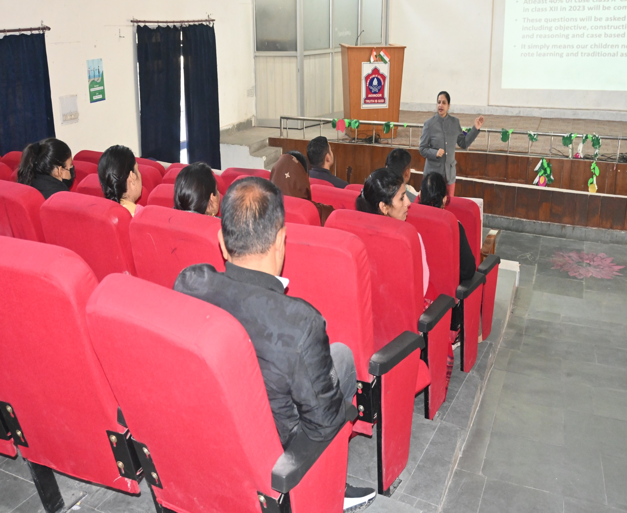
PARENTS COUNSELING SESSION
( By Mrs. Geeta Sharma, The Principal of APS Akhnoor)

Slide 4
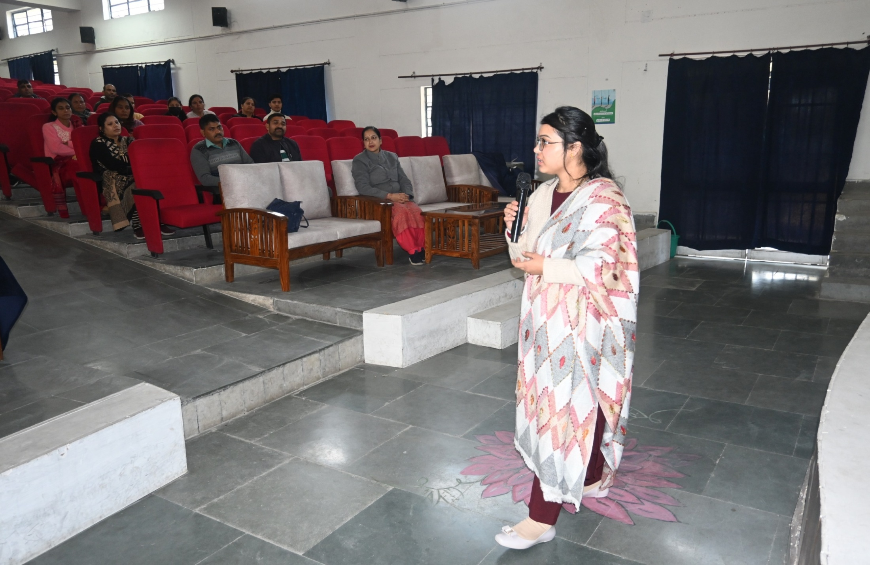
PARENTS COUNSELING SESSION
( By Ms. Neha Choudhary, Clinical Psycologist)

Slide 5
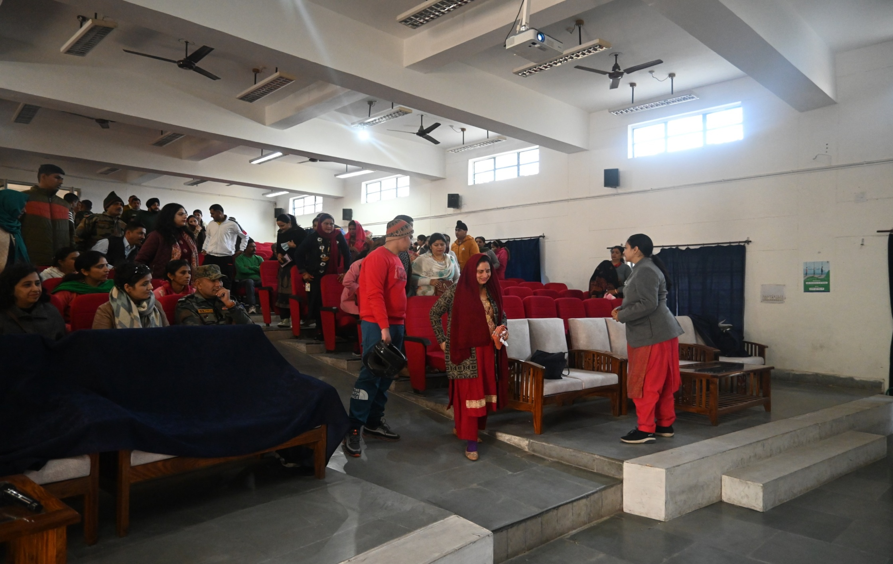
PARENTS COUNSELING SESSION
( By Mrs. Geeta Sharma, The Principal of APS Akhnoor)

